Slide 1


Slide 2

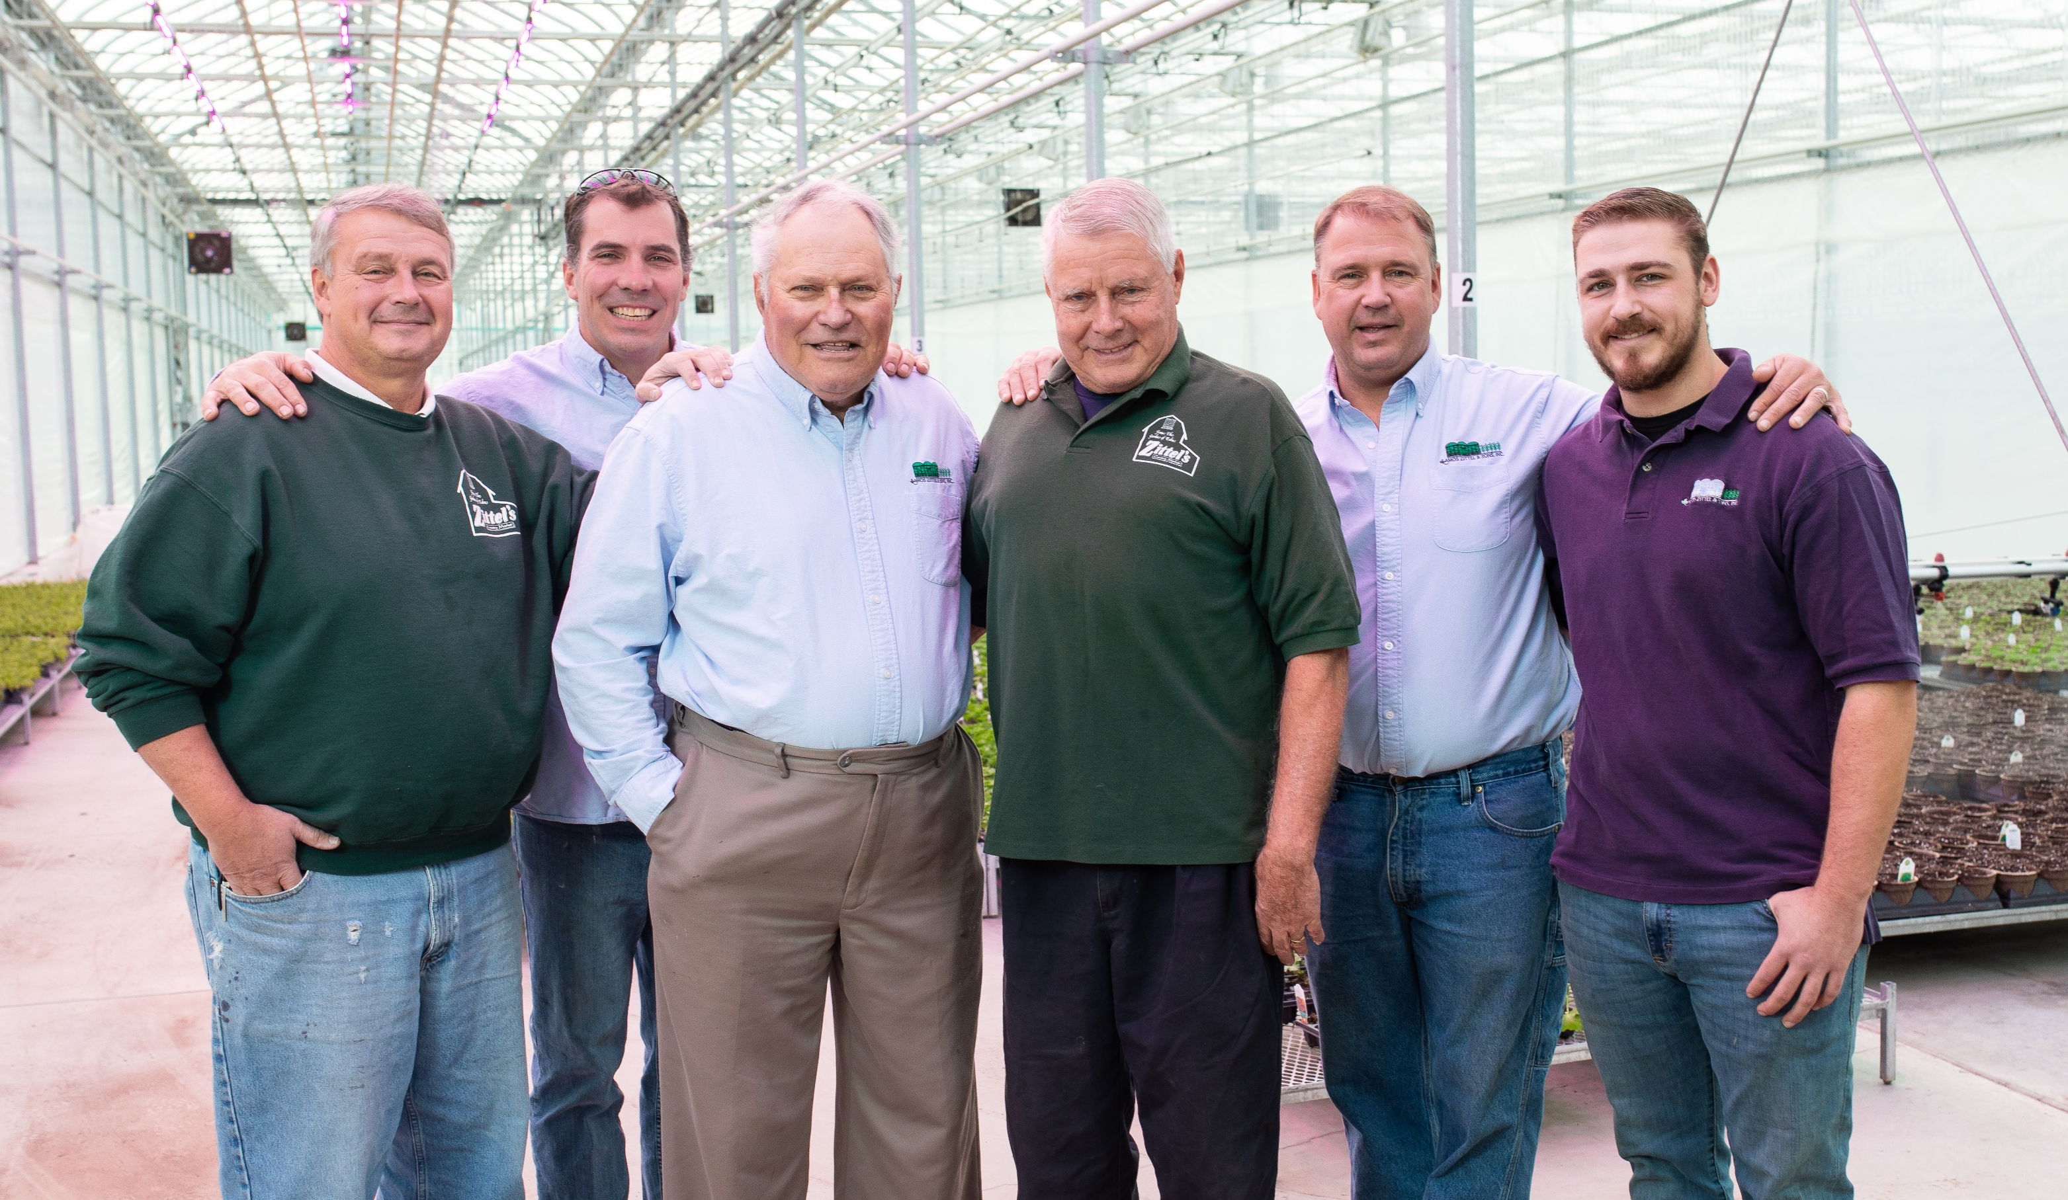
George F. Zittel 1896 (started Farm) Amos Zittel 1908
Bill, Kevin, Paul, George, David, Evan

Slide 3

Dan Tomaka, Terry Zittel, Carol Demier, Sandra Wiltshire,
(Erin Rudoff - Not Pictured)

Slide 4
Amos Zittel & Sons, Inc.
  Started Growing Geraniums in 1964
  Family owned and operated
  Wide Selection of Products
  Quality and Customer Service is our priority, paying close attention to detail and going the extra mile for our Customers and Sales Reps
  Grower Truck available
  99.8% order fill in 2026
  Mix and match 18 different varieties in one box
  With minimums as low as 26
  Over 20 years of experience using biologicals

Slide 5

Snowvember 2014 destroyed our Greenhouses and We lost another ½ acre in Nov 2022

Slide 6
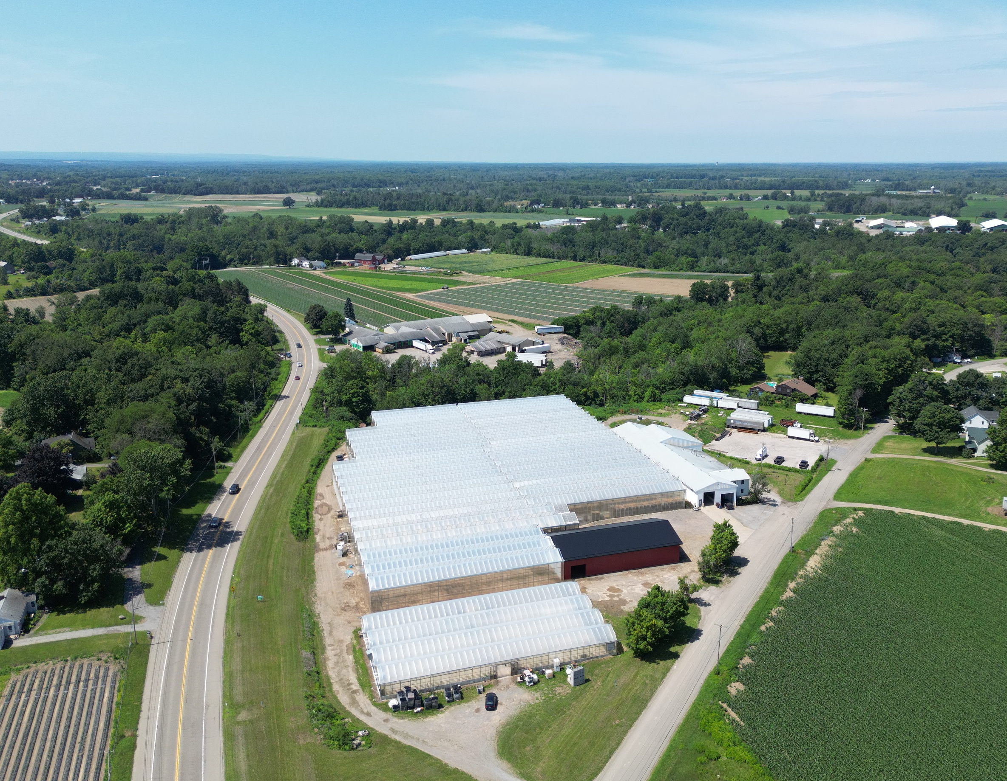
Rebuilt ½ acre at this location

Slide 7
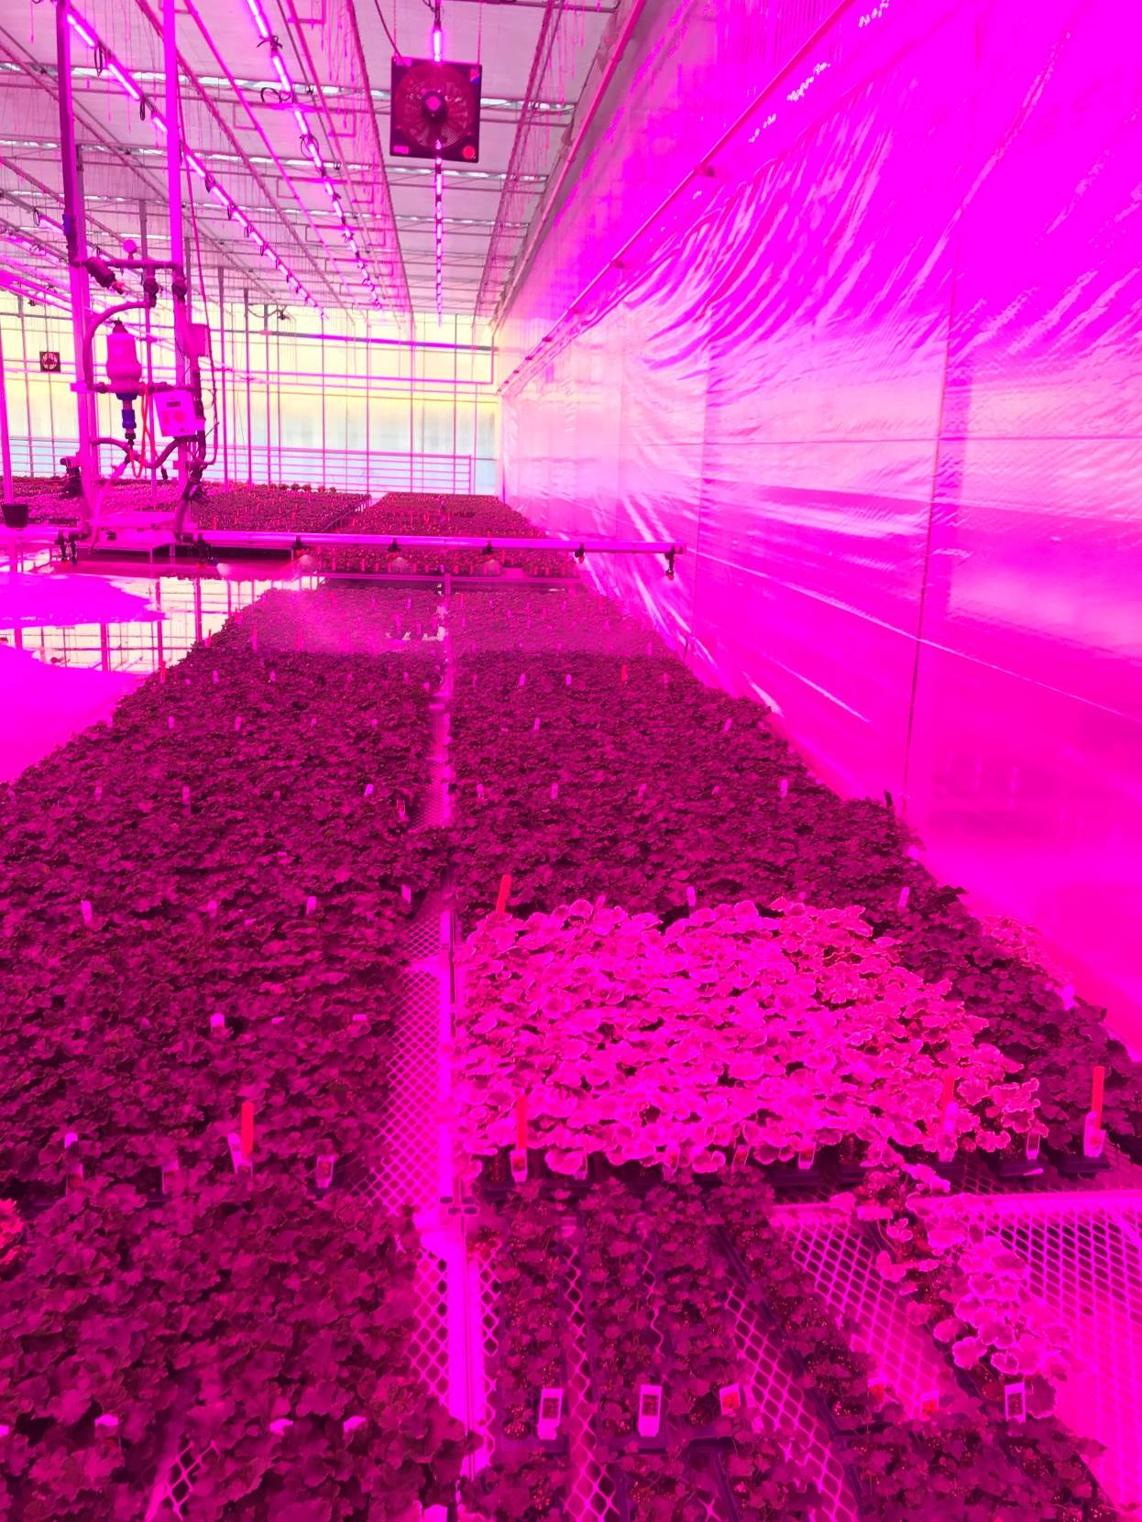
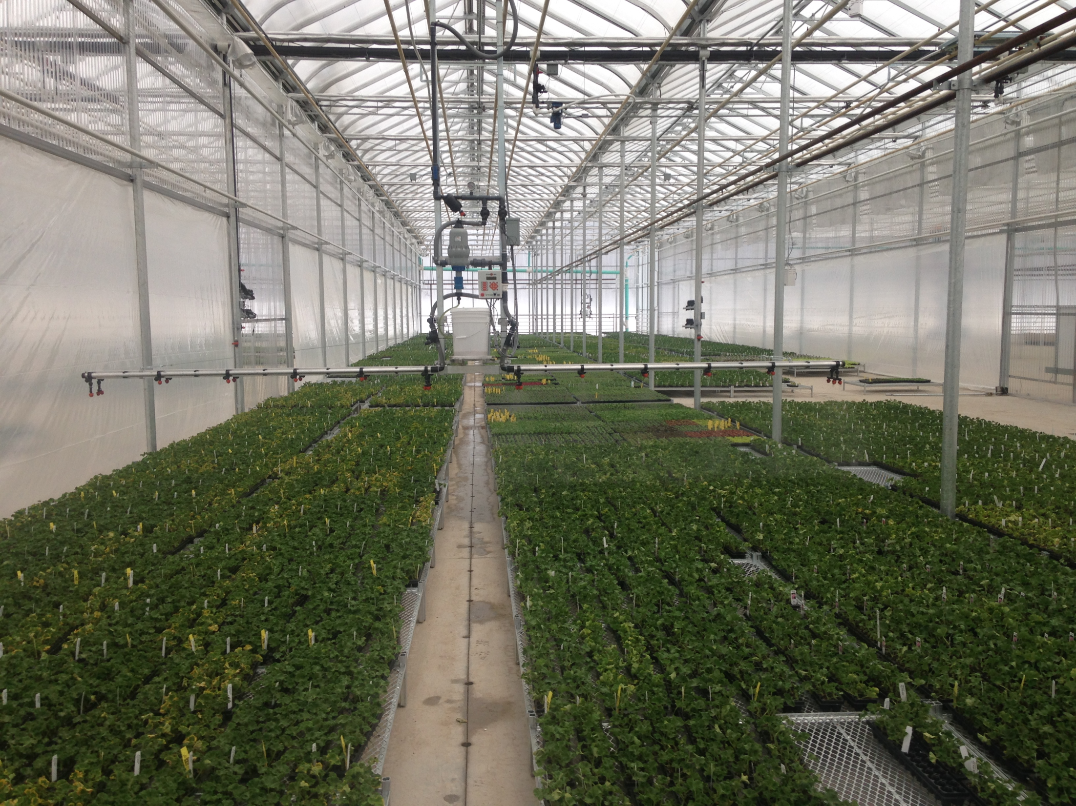
Incorporated State of the Art Technology including lights, Watering Booms and Damatex Environmental Computer System affording better efficiencies and quality

Slide 8
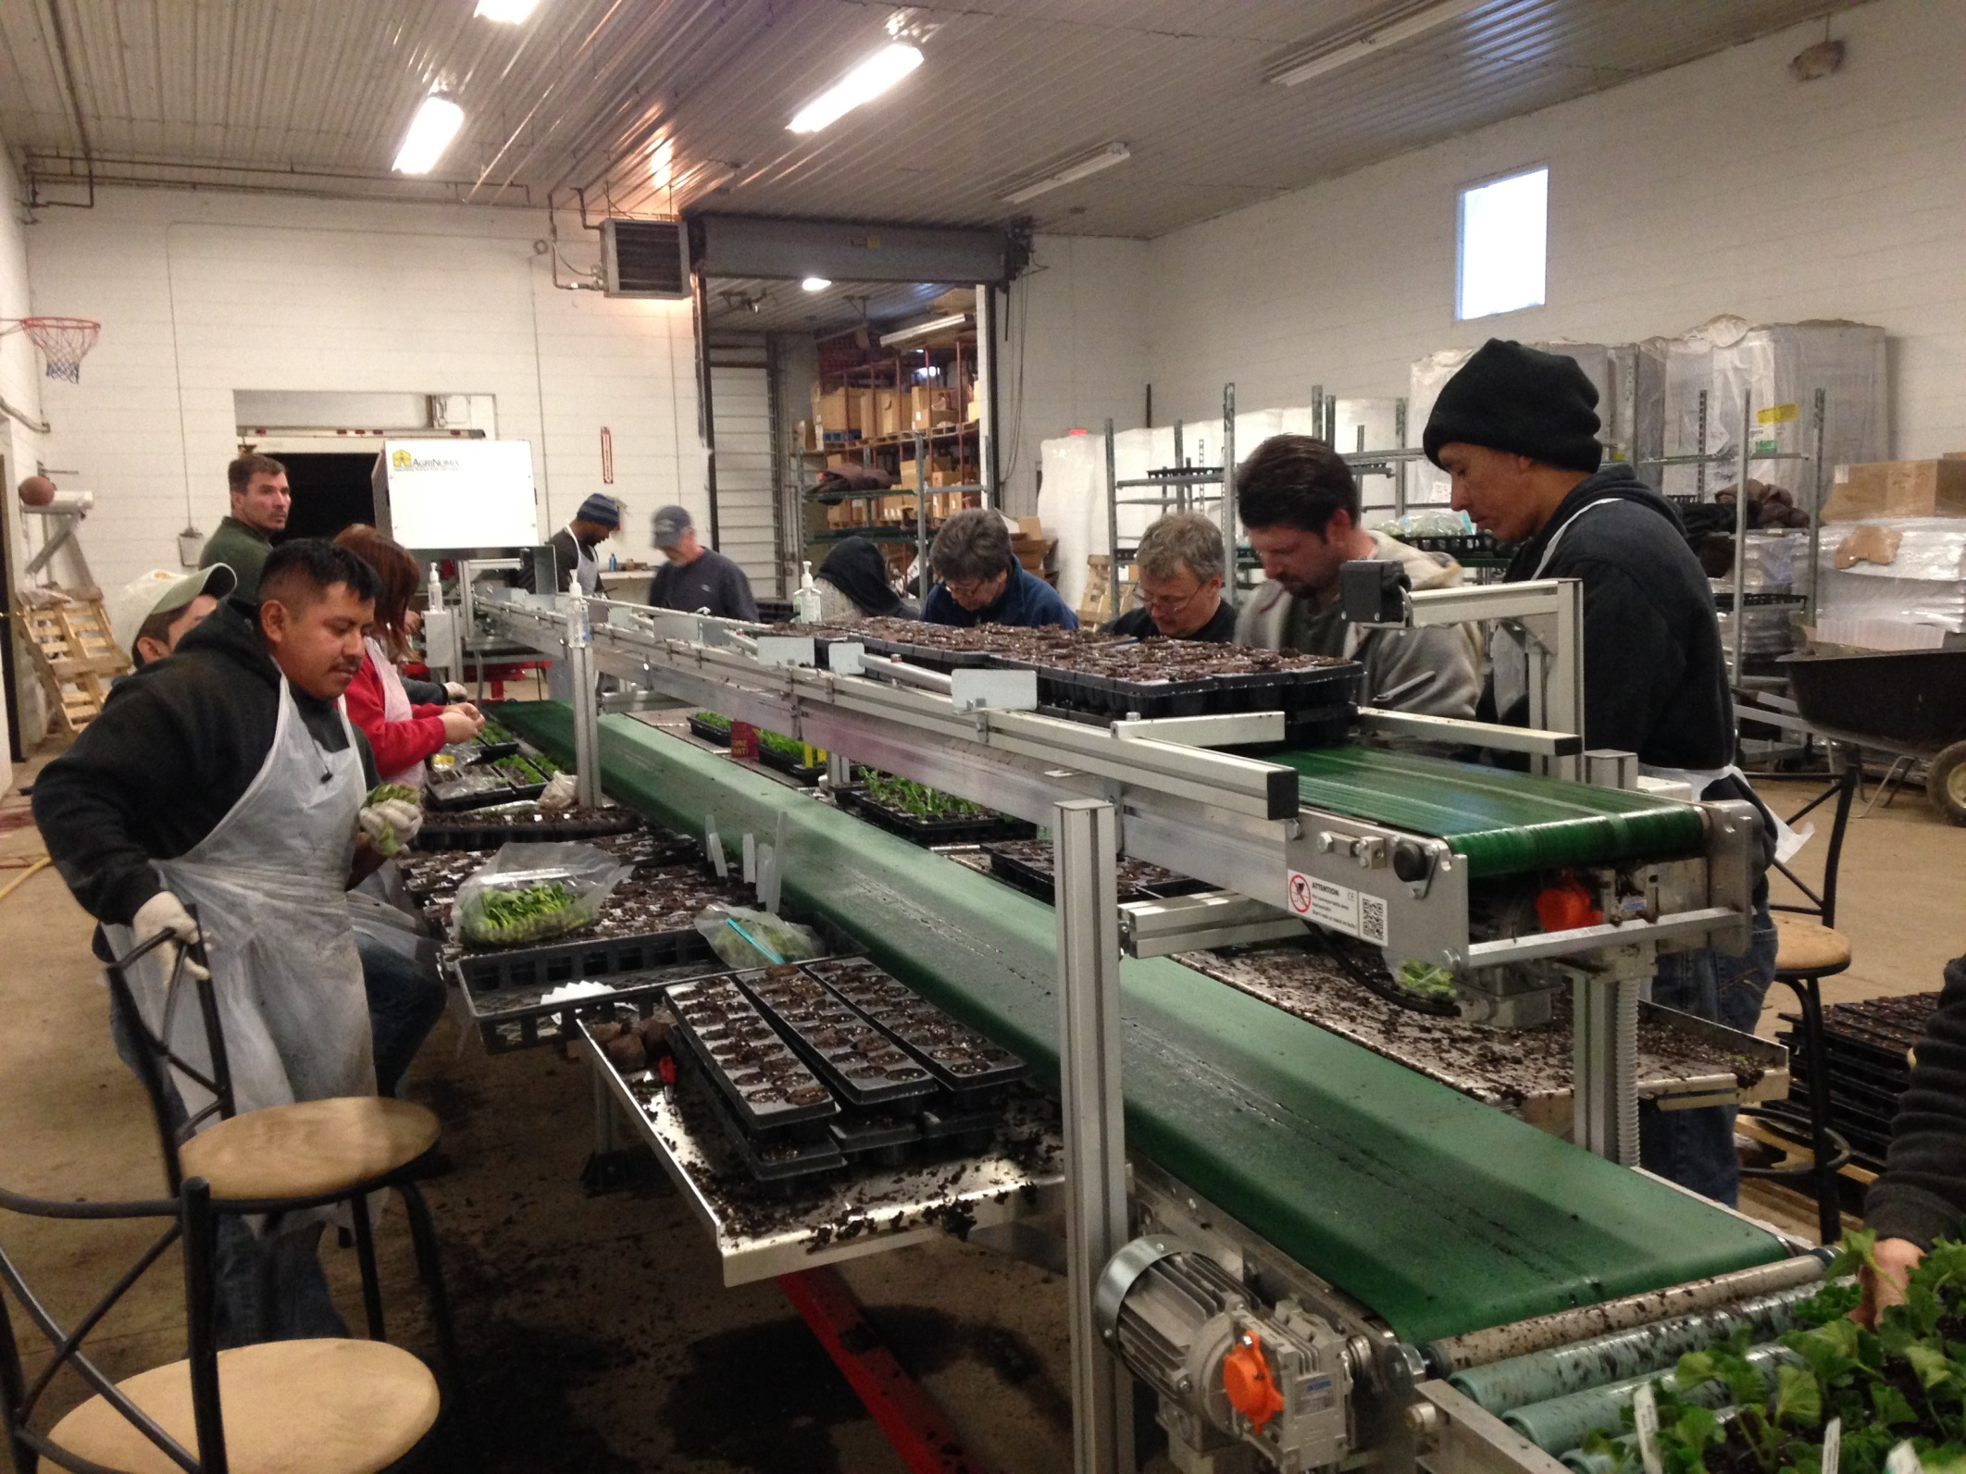

Slide 9
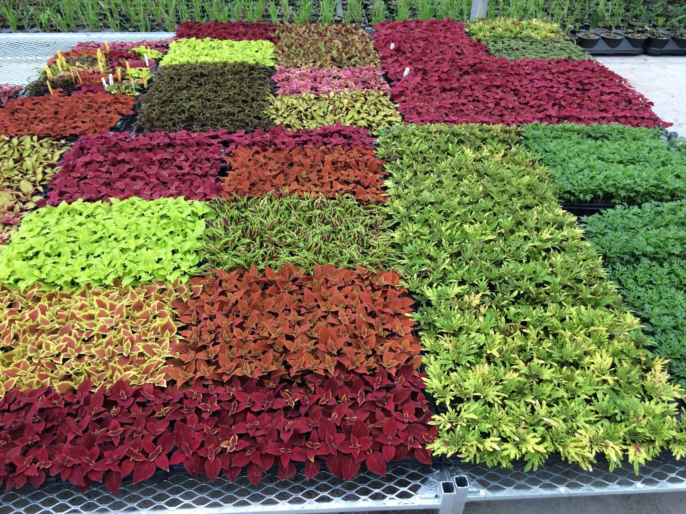
Invested in Picas –B2B and will provide Real Time Inventory availability

Slide 10
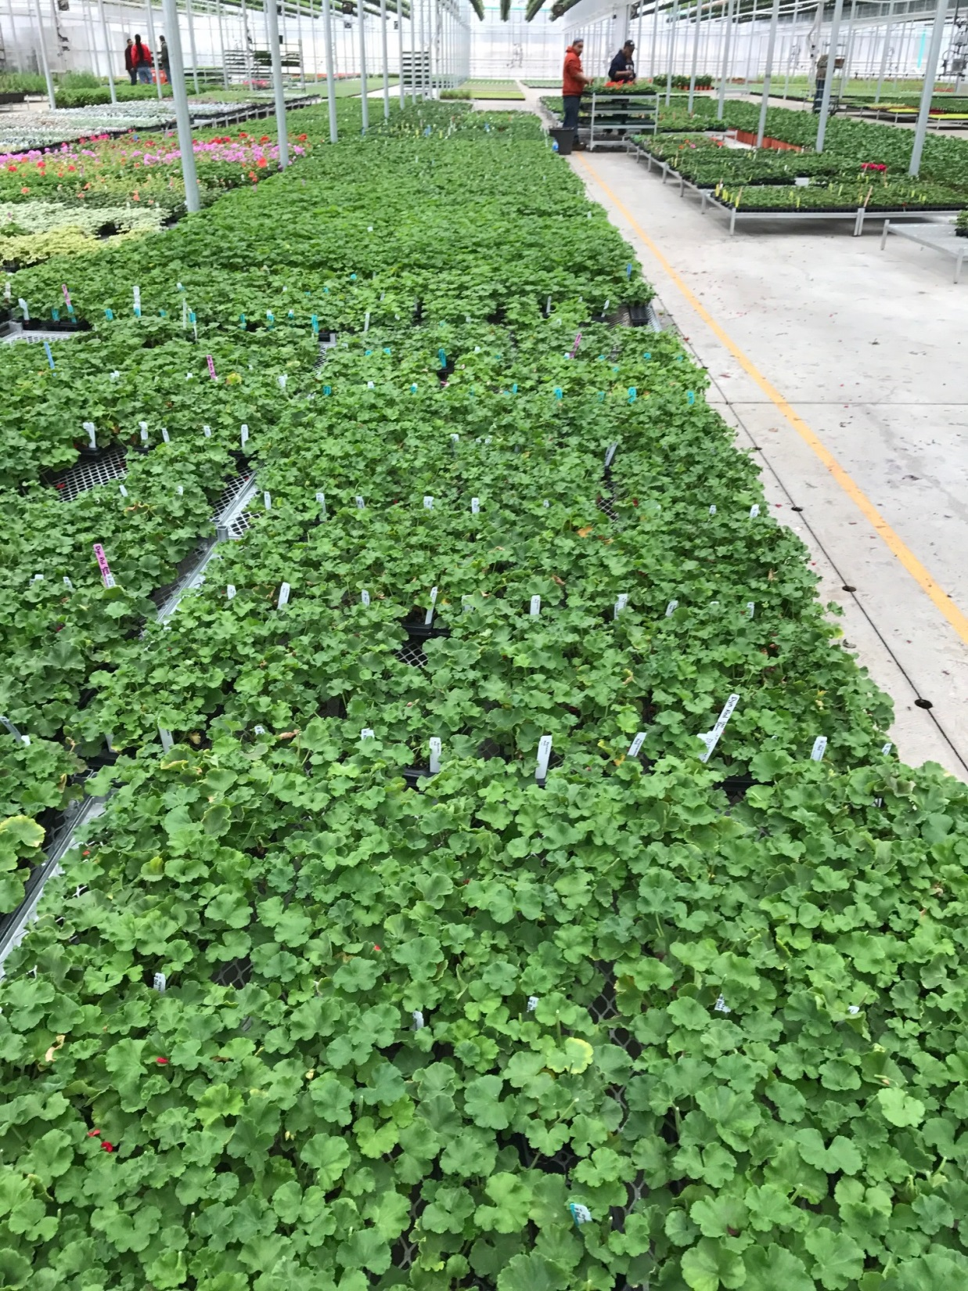

Slide 11
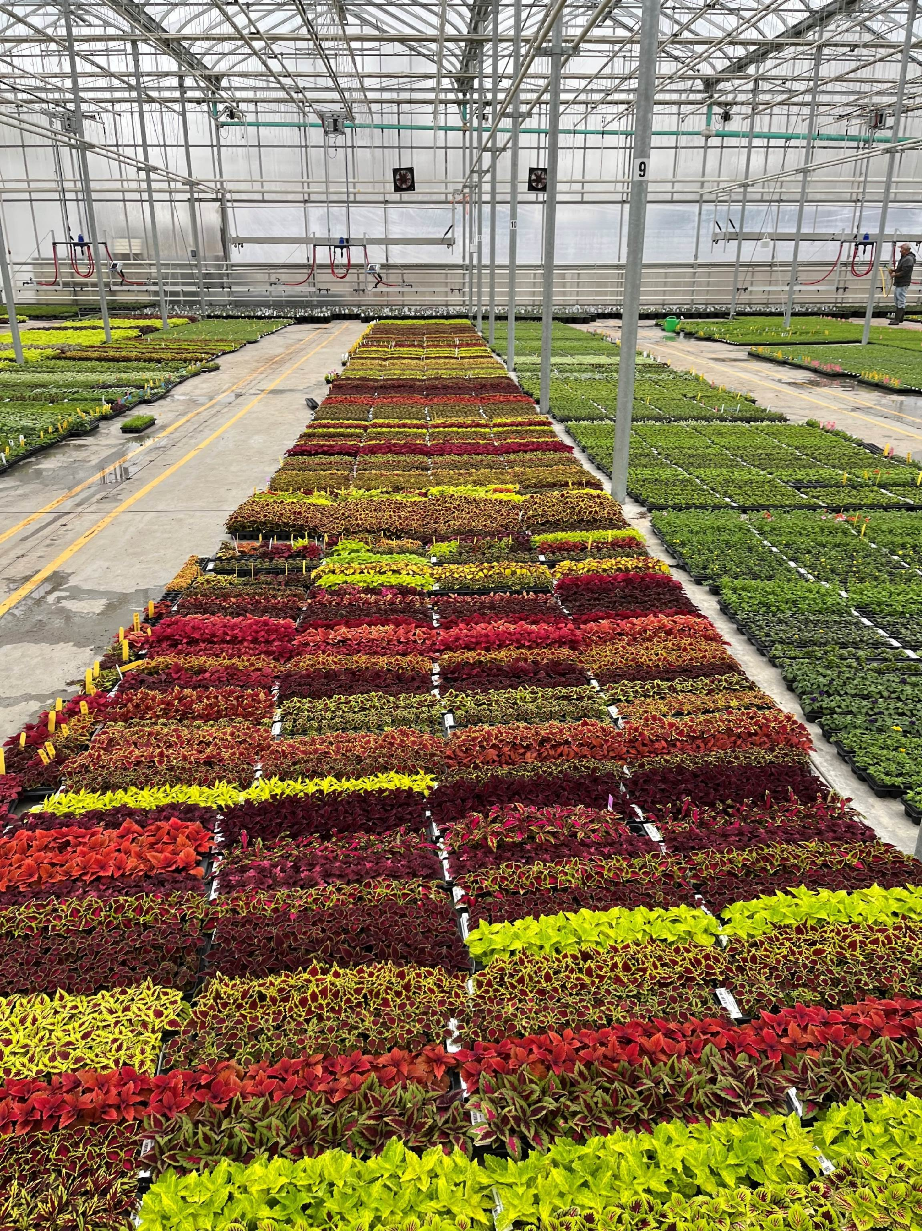

Slide 12
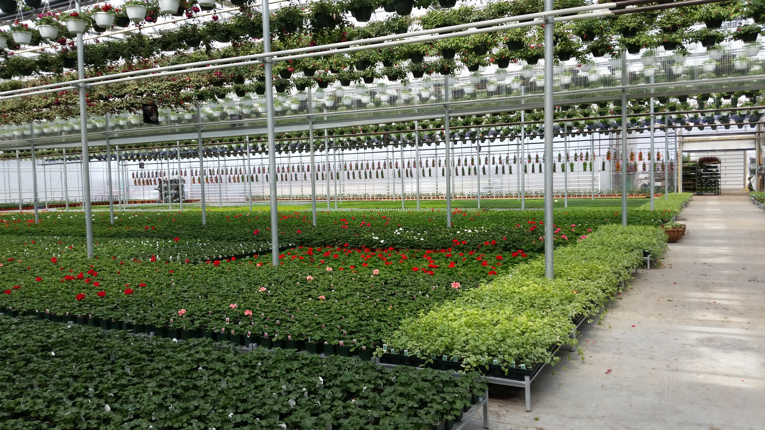

Slide 13
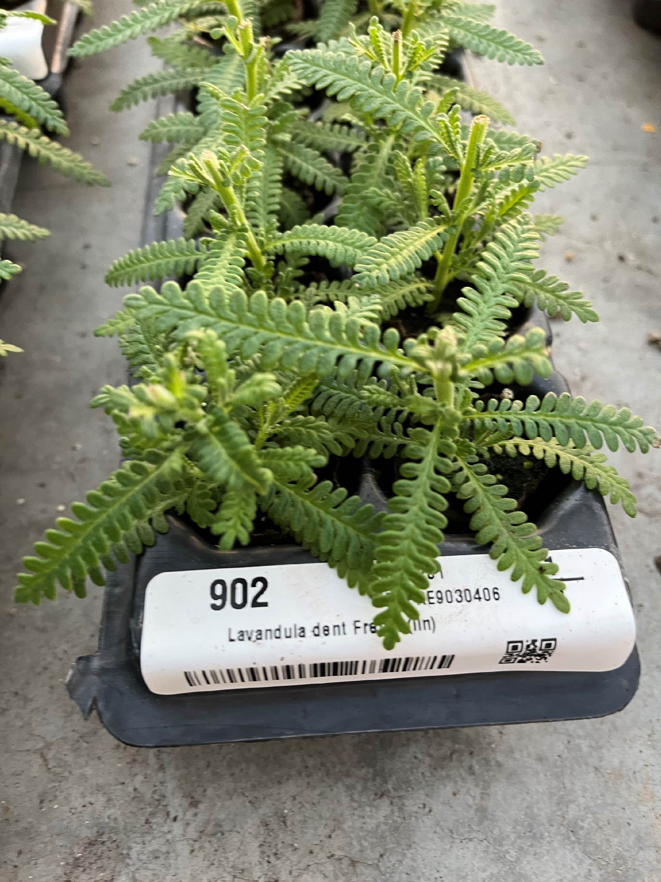
Huge Selection of Products
One Stop Shop!
NE Supplier with over 1,600 varieties/1875 items:
Offering BFP, Dummen, Syngenta, Danzinger, Selecta and other Genetics
Herbs and Spring Plants grown as 30mm
Geraniums offered as:
    30 mm (4 wks),
    40 mm (6 wks)
    prefinished 4.5” (7 wks)
  Shipping wk 1-16
    Fuchsia wk 50-14
    Elegance wk 50-12
    Herbs til wk 18
  Tags drop shipped

Slide 14
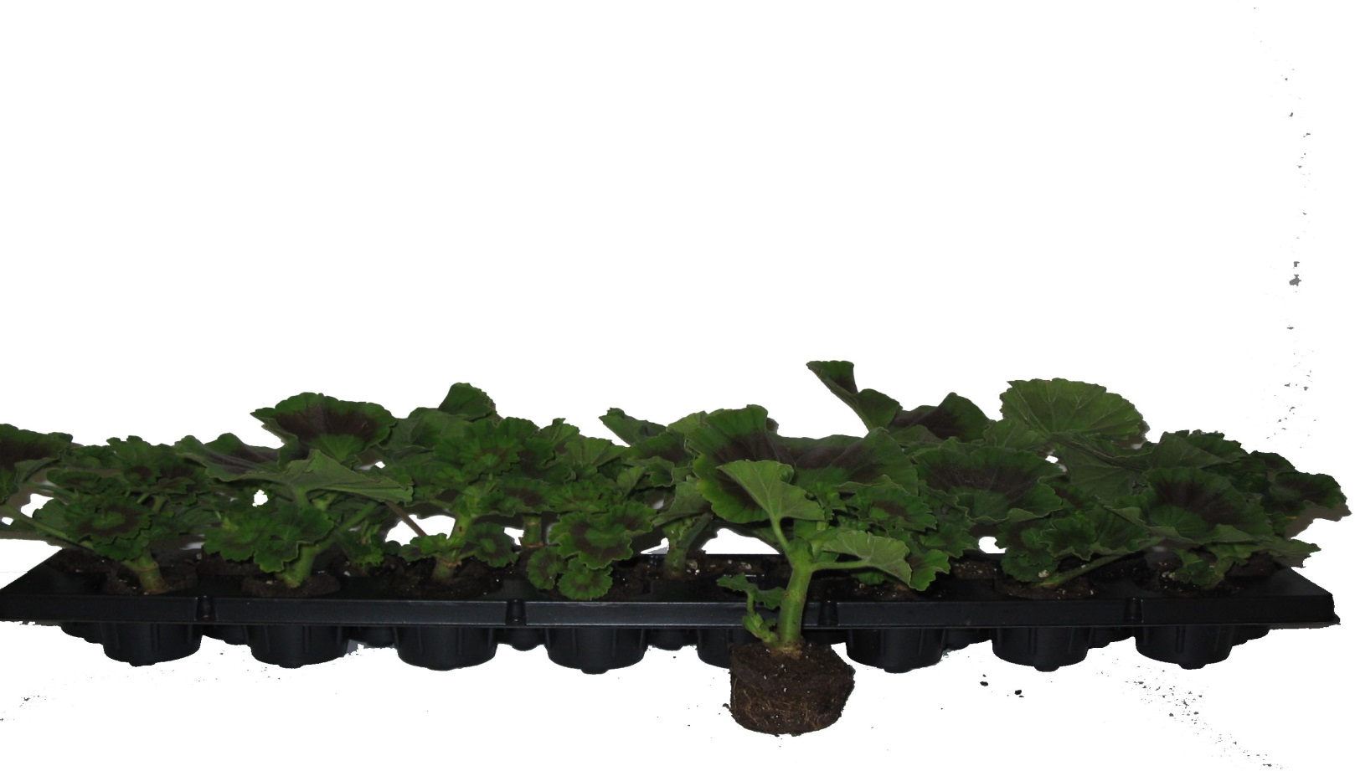
Geraniums 17 Strip
Grown in 40 mm Elle
  Faster to Finish and allows customers to open greenhouse later
  6 weeks grow time
  17 plants per strip allows spacing for greater aeration
  Minimum 34 per variety
  Shipped 204 per Fed Ex Box
  68 per RPC (4 strips)

Slide 15
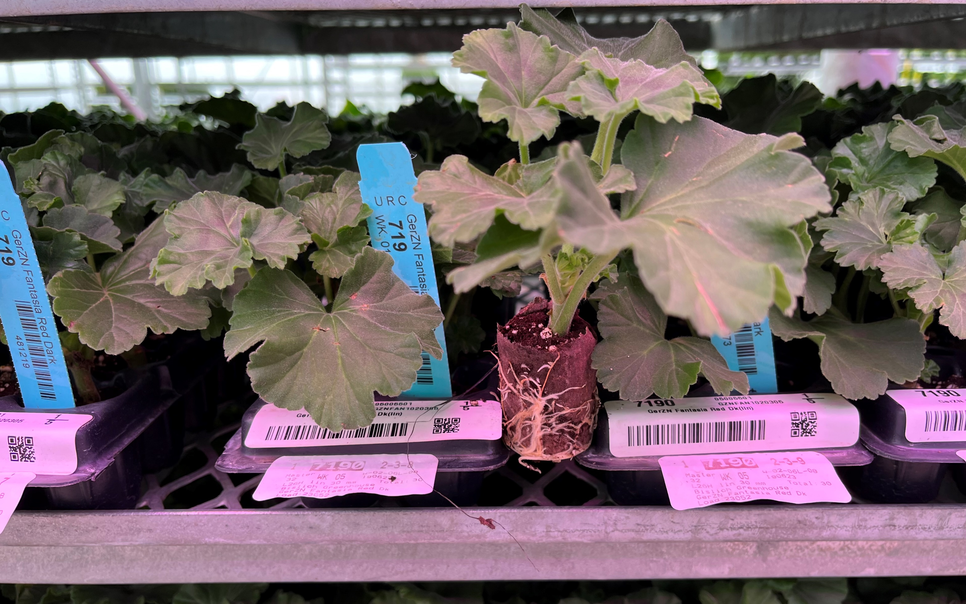
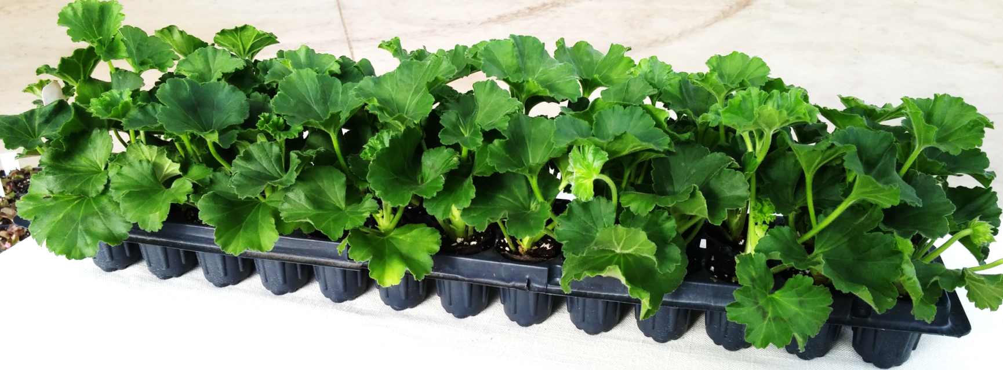
Geraniums 26 Strip
Grown in 30 mm Elle
  4 weeks Grow Time
  26 plants per strip
  Minimum 26 per variety
  Shipped 312 per Fed Ex Box
  104 per truck tray (4 strips)

Slide 16
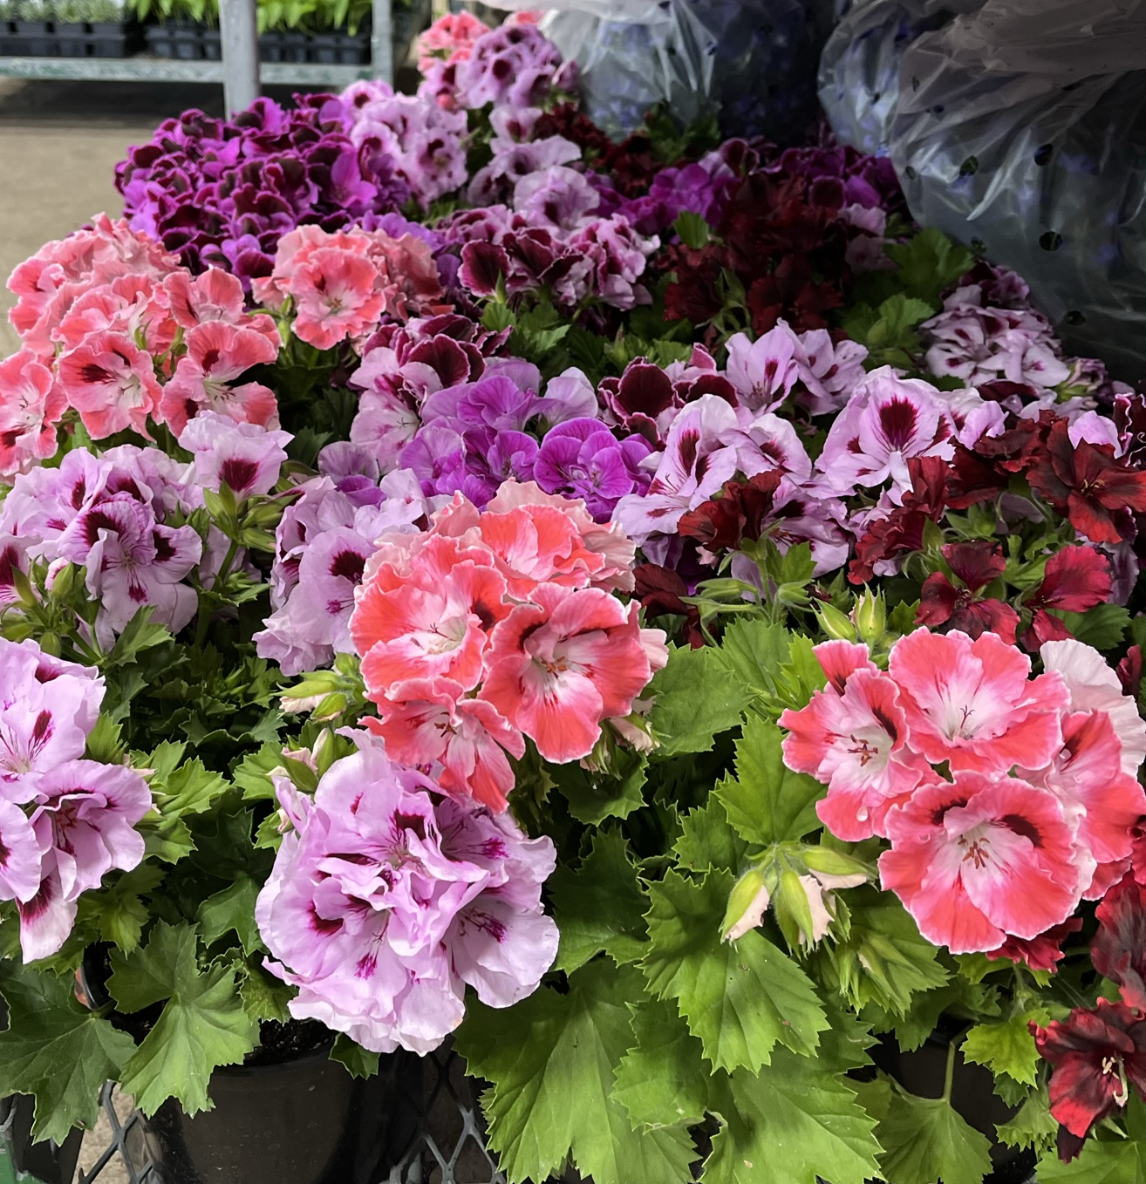
Regal Geraniums
Martha Washington
Regal Geraniums - Available week 50-12
  Grown in 50 mm Elle
  Pinched and pre-cooled
  12 week crop time
  32 per tray
  128 per box

Slide 17
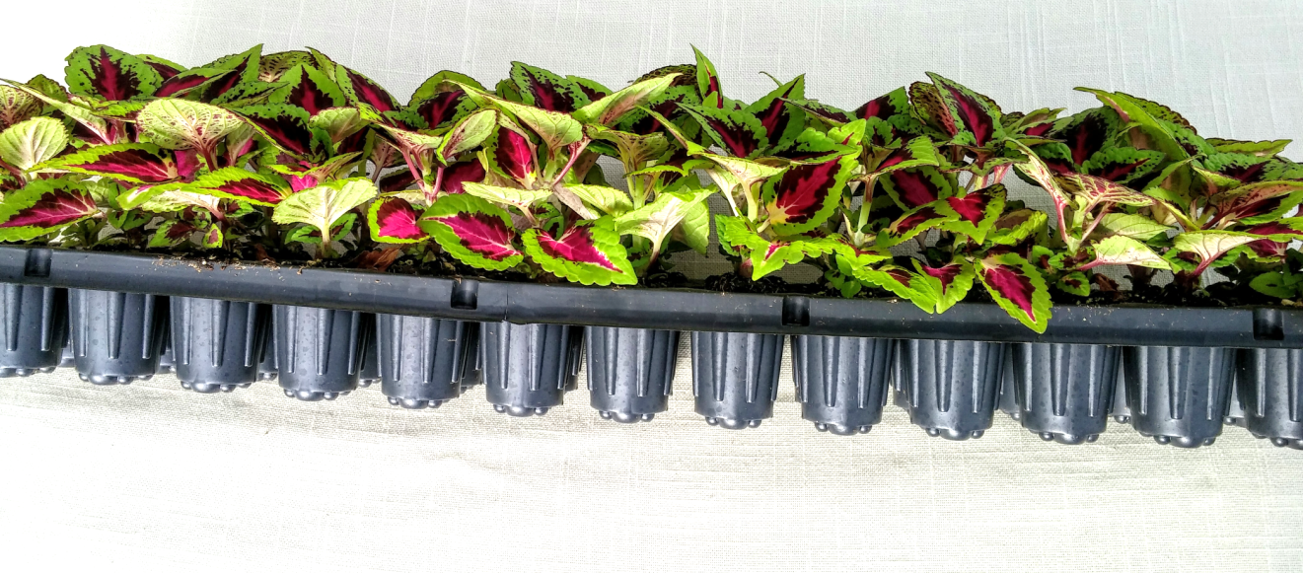
Spring Garden Plants
Grown in 30 mm Elle
  Smaller minimums – only 26 per variety
  Quick to finish
  Mix and Match 18 strips of 26 plants in one box
  468 plants per box
  Can mix and match w/ geraniums & fuchsia

Slide 18
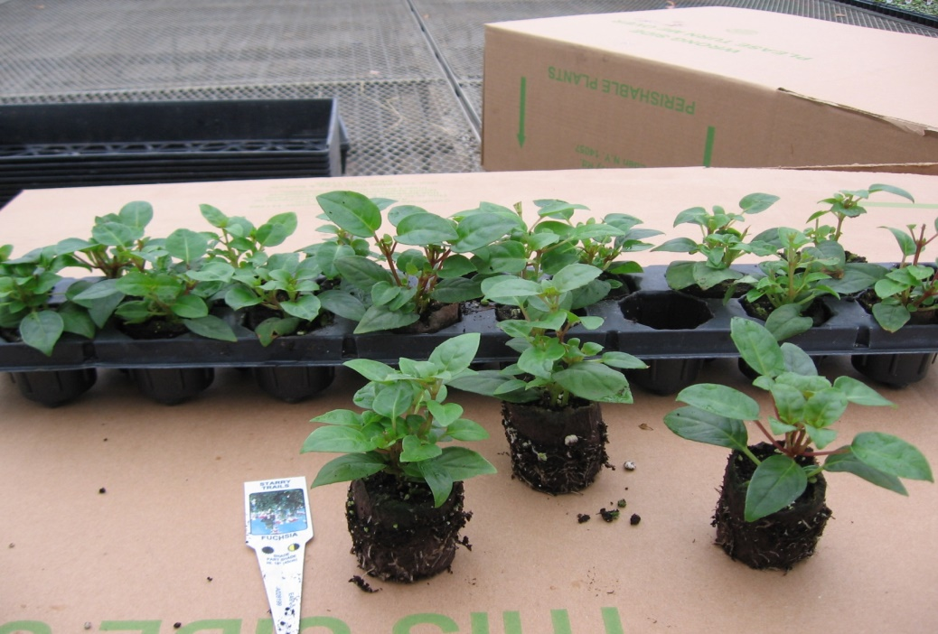
Fuchsia
Grown in 40 mm Elle 17 plants per strip
Double Pinched
Quick to finish - suggest for Mother’s Day Finish:
  4 per 10” pot if planted in February
  5 per 10” pot if planted in March
Low Minimums 17 per variety, 312 per box
    18 strips/box

Slide 19
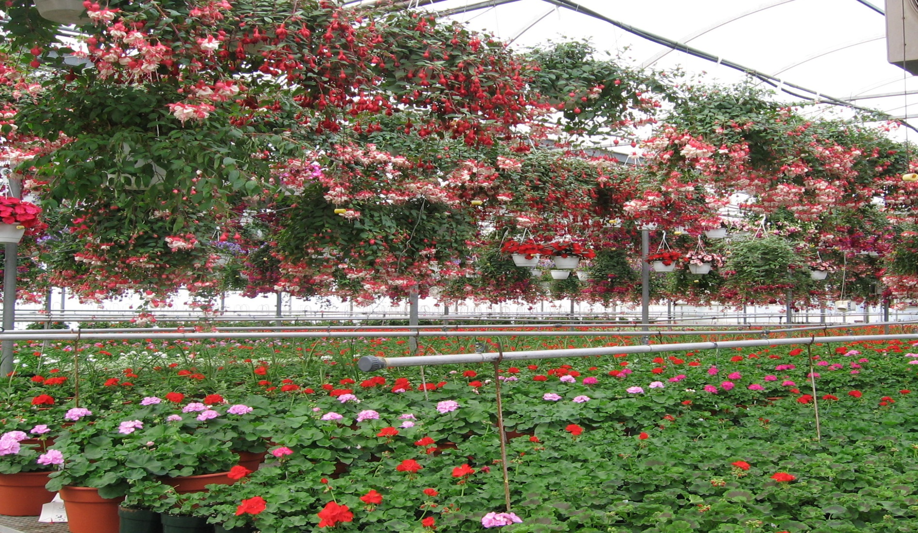
Finished Fuchsia Baskets

Slide 20
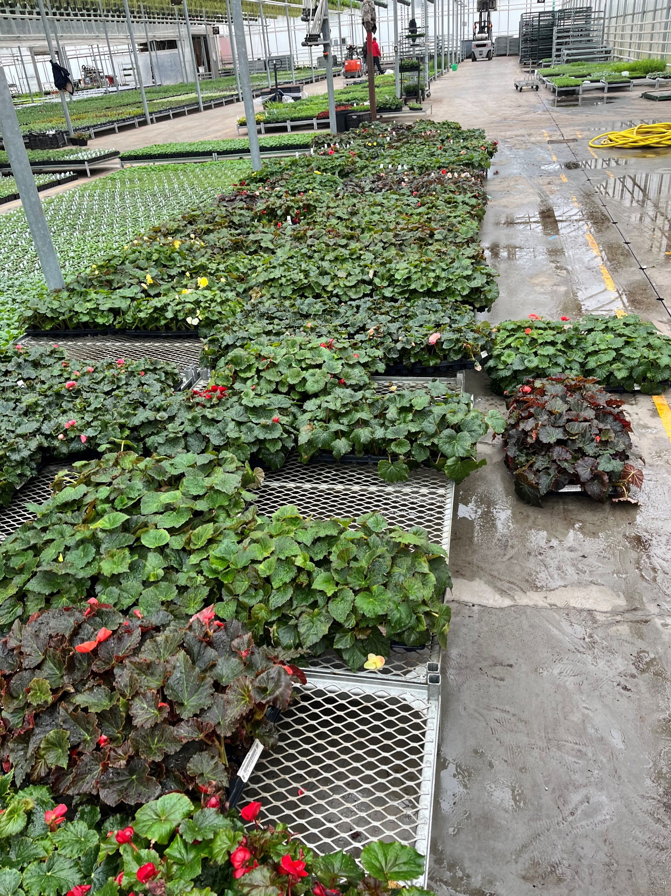
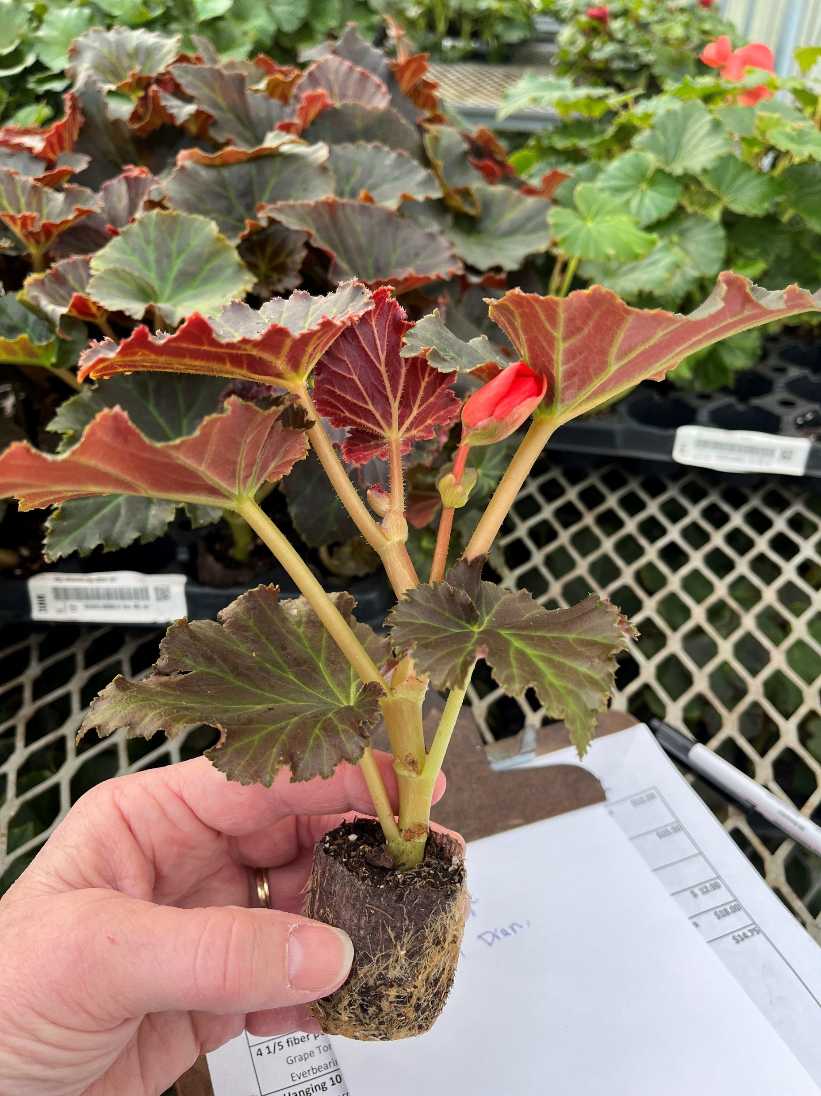
Begonias
Grown in 40 mm Elle
5-6 weeks Grow Time
  17 plants per tray
  Plants are grown under LED’s during whole
  liner cycle to cut down on blanks
  Minimum 34 per variety (2 trays)
  12 trays/box

Slide 21
Herbs 2026-2027

Slide 22
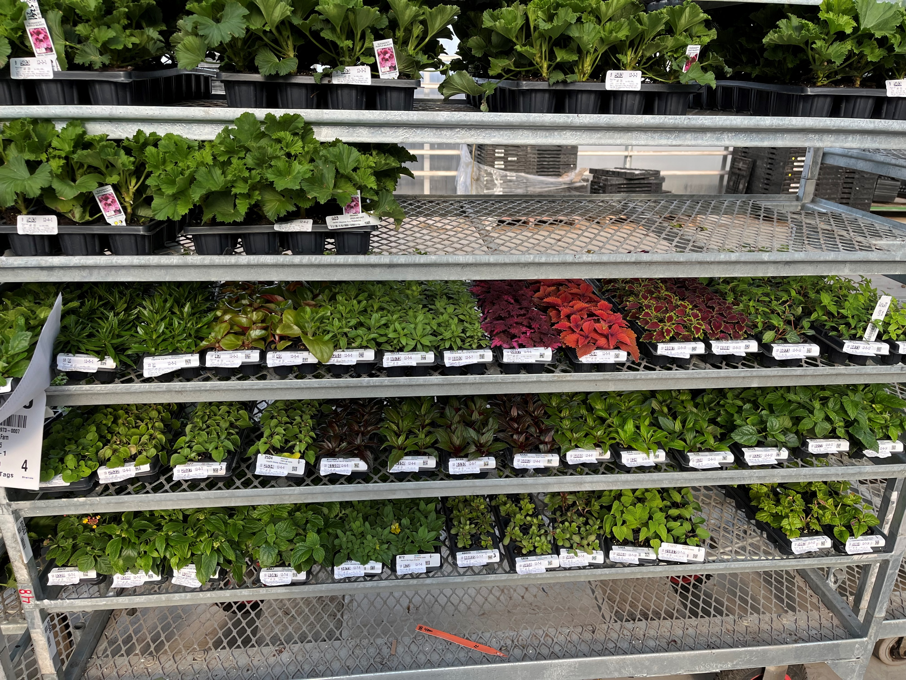

Slide 23
Shipping
Fed Ex
  Careful to watch weather –often call customer
  Full Box - 18 Strips Vegetative-Shorter product
12 strips Geraniums–Taller product
  ½ Box available – 9 strips shorter and 6 if taller
Grower Truck
  Rack or open stackable RPC
  No real minimums if on the route and customer is flexible
  Cross dock or drop at central location
Truck– Palletized and heat protected (i.e. ADP)
Tags Dropped Shipped

Slide 24
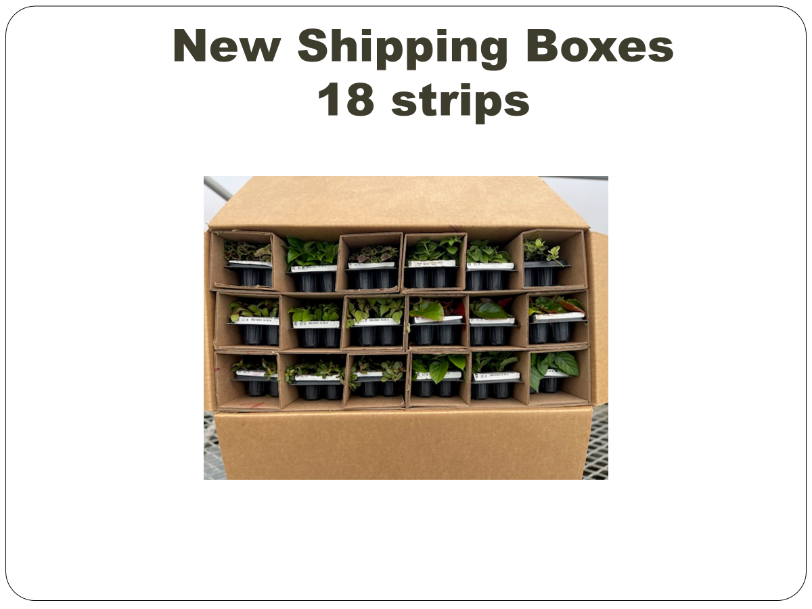

Slide 25
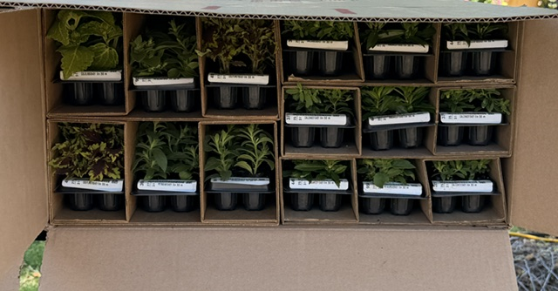
Mix & Match with 26 & 17’s
6” high sleeve-Packed 12 sleeves to a box
4” high sleeves-Packed 18 sleeves to a box
  Can Mix and match 26 and 17

Slide 26
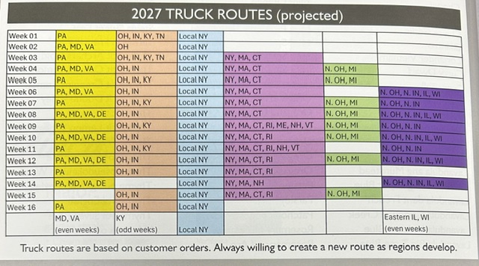
2027 Truck Routes

Slide 27
 | 2027 Truck rate chart based on miles and quantity of trays
26/17 strips |  | miles | min | 36-250 trays | 250-500 trays | >500 trays
zone | 1 | 0-35 |  | 0 | 0 | 0
zone | 2 | 35-170 | 50 | $1.50 | $1.25 | $1.00
zone | 3 | 171-400 | 60 | $1.75 | $1.50 | $1.25
zone | 4 | 401-600 | 70 | $2.00 | $1.75 | $1.50
zone | 5 | >600 | 80 | $2.25 | $2.00 | $1.75
 | 50 and 32 tray = 3x the chart above.
 | Trixi, Mixmaster and Regals
50/32 trays |  | miles | min | 36-250 trays | 250-500 trays | >500 trays
zone | 1 | 0-35 | 0 | 0 | 0 | 0
zone | 2 | 35-170 | 0 | $4.50 | $3.75 | $3.00
zone | 3 | 171-400 | 0 | $5.25 | $4.50 | $3.75
zone | 4 | 401-600 | 0 | $6.00 | $5.25 | $4.50
zone | 5 | >600 | 0 | $6.75 | $6.00 | $5.25
This is tentative but hopefully the basis for our truck rates.

Slide 28
Marketing Tools for Sales Reps
https://zittels.com/wholesale-rooted-liners/
Wholesale Rooted Liners – Zittels
Catalog
Add/Drop list
Flyer – Double Sided Color with highlights and series
Complete Listing of all Varieties

